Slide 1

COVID CHAT-BOT
DON BOSCO INSTITUTE OF TECHNOLOGY DBIT
COMPUTER ENGINEERING 2020-2021
GROUP MEMBERS:
RUCHA BHOSLE 04
ELYSIA D’SOUZA 18
NIKITA D’SOUZA 21

Slide 2
PROBLEM STATEMENT
In times of crisis, communications systems are often overwhelmed with people trying to find basic information about testing, symptoms, community response, and other resources. When communication lines get clogged, people who need real help can't get through. Chatbots help respond to tens, even hundreds, of thousands of messages a day.This workshop will use IBM Cloud technologies to build a virtual assistant able to understand and respond to common questions about COVID-19, scan COVID-19 news articles, and respond to COVID statistics inquires with data from trusted sources. This workshop will using Watson Assistant to build a chatbot, Watson Discovery to find information from trusted sources.

Slide 3

CLOUD USED
IBM- International business machines IBM Cloud provides a full-stack, public cloud platform with various products in the catalog, including options for compute, storage, networking, end-to-end developer solutions for app development, testing and deployment, security management services, traditional and open source databases, and cloud-native services.

Slide 4
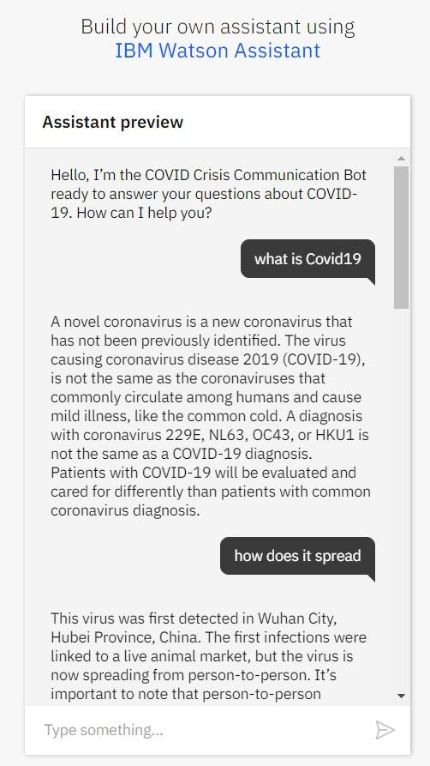
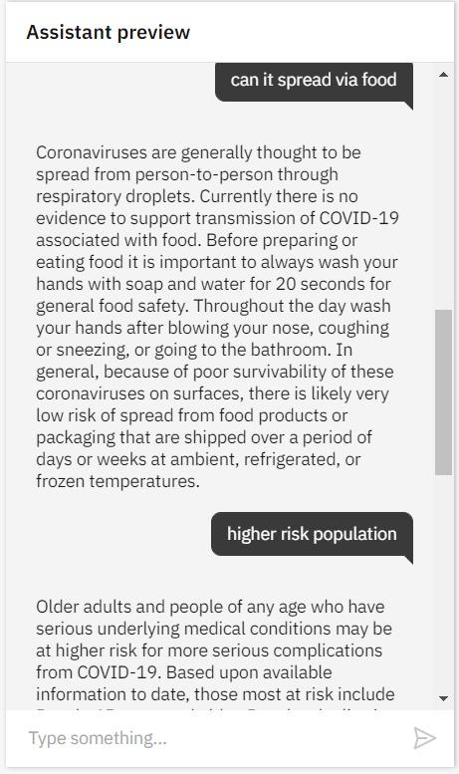
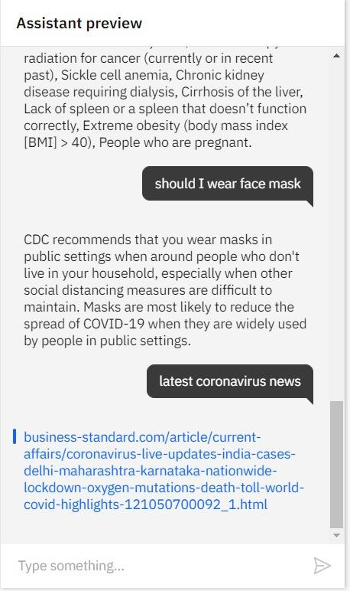
OUTPUT:

Slide 5
PROBLEM STATEMENT
With a million of books released it becomes difficult to find the details of a book you want to find and it becomes difficult to store the details of all these books on a single machine. Thus cloud can be used in order to store this data. With the help of this an app can be created to fetch the data from cloud and display the required book details to the user.

Slide 6

CLOUD USED
Heroku Heroku is a platform as a service (PaaS) that enables developers to build, run, and operate applications entirely in the cloud.

Slide 7
METHODS USED
Database used Postgresql Interface used Adminer Website built with Flask, Python

Slide 8
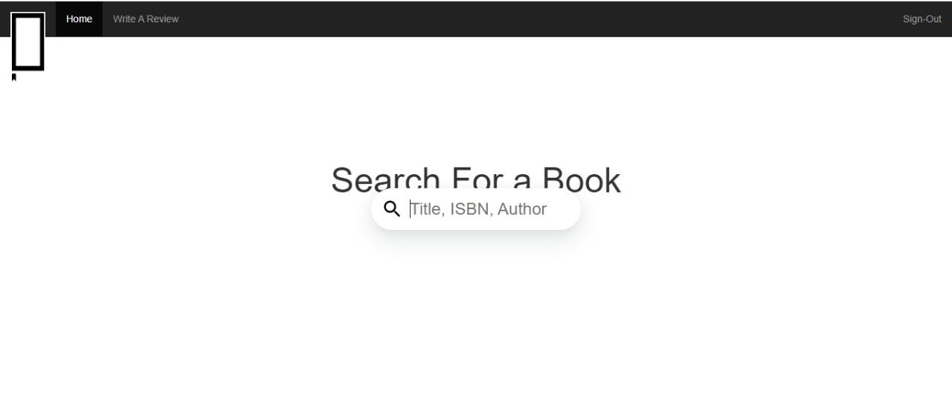
OUTPUT

Slide 9
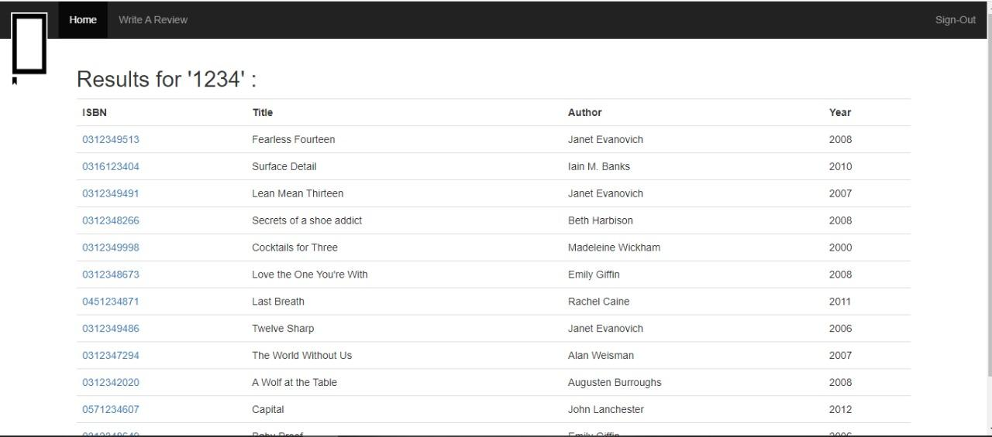
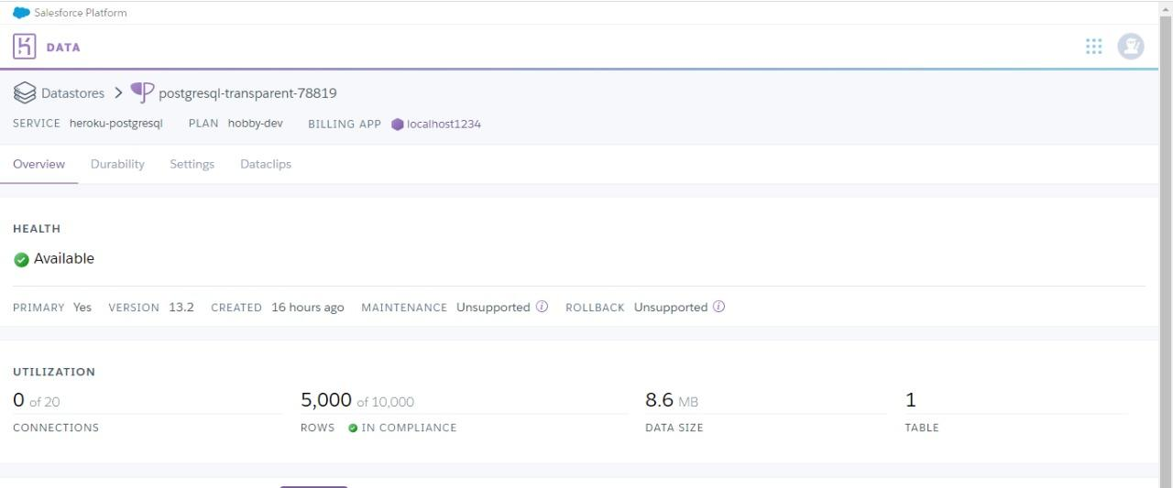

Slide 10
